Slide 1
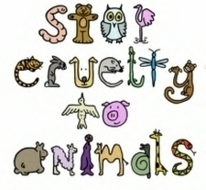
Cruelty to Animals
SJ Lesson
10/17/11

Slide 2

What is Humane Treatment of Animals?
The humane treatment of animals means to care for all animals by fostering kindness, respect, empathy, and a sense of responsibility for their welfare.

Slide 3
What is Animal Exploitation?
ANIMAL EXPLOITATION:
Individuals and groups express an opinion that humans have absolute control over animals. They can be used or abused as humans see fit. They are here to serve human purposes without restriction for sports, profit, etc. There are no moral or legal restrictions. Animals exist to meet human needs and enhance human life styles. Often these individuals and groups will ignore the laws of their state regarding the use and exploitation of animals.

Slide 4
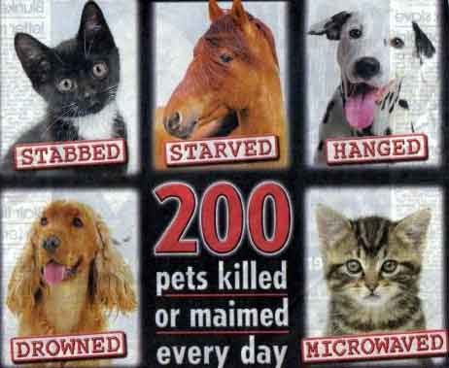

Slide 5
What is Animal Welfare?
ANIMAL WELFARE:
Individuals and groups express a responsibility to protect animals from harm. While they feel that animals can be used to meet human needs for food, scientific research, clothing, companionship, work, sport and entertainment, this is to be done in as humanely a manner as possible; fostering kindness, respect, empathy, and a sense of responsibility for both human and nonhuman animals. They feel that limits should be set on animal use for human purposes and in order to achieve socially acceptable standards, these activities may need to be regulated by law.

Slide 6
11 Facts About Animal Cruelty
In many circuses, wild and exotic animals are trained through the use of intimidation and physical abuse. Former circus employees have reported seeing animals beaten, whipped, poked with sharp objects and even burned to force them to learn their routines!
Elephants who perform in circuses are often kept in chains for as long as 23 hours a day from the time they are babies.
More than 25 million vertebrate animals are used in testing in the United States each year. When invertebrate animals are thrown into the mix, the estimated number rises to as high as 100 million.

Slide 7
11 Facts About Animal Cruelty
By 2022, 22% of all species will be extinct if no action is taken.
If you live in Pennsylvania, California, Florida, Rhode Island, Illinois, Virginia, Oregon, New York, New Jersey and Vermont you have the legal right to refuse to participate in dissection in class! In Louisiana, there is a State resolution and in Massachusetts, Maine, Maryland and New Mexico, there are Departments of Education resolutions in place that allow you to refuse to dissect, although it hasn’t yet become a law.
Dog fighting and cock-fighting are illegal in all 50 states.
It is estimated that on average it takes 1,000 dogs to maintain a mid-sized racetrack operation. New greyhounds are continually entering the system to replace greyhounds that grade-off due to injury, age or poor performance. There are currently over 30 tracks operating in the United States.

Slide 8
11 Facts About Animal Cruelty
8. Tens of thousands of wild and domesticated horses from the United States are cruelly slaughtered every year to be used for horse meat in Europe and Asia. Since the last horse slaughter plants in the U.S. were closed in 2007, thousands of horses have been shipped to Canada and Mexico for slaughter.
9. Many studies have found a link between cruelty to animals and other forms of interpersonal violence.
10. Neglect and abandonment are the most common forms of companion animal abuse in the United States.
11. A fur coat is pretty cool—for an animal to wear. Eighteen red foxes are killed to make one fox-fur coat, 55 minks to make a mink coat.

Slide 9
How to Recognize Animal Cruelty
Physical Signs
Collar so tight that it has caused a neck wound or has become embedded in the pet’s neck
Open wounds, signs of multiple healed wounds or an ongoing injury or illness that isn’t being treated
Untreated skin conditions that have caused loss of hair, scaly skin, bumps or rashes
Extreme thinness or emaciation—bones may be visible
Fur infested with fleas, ticks or other parasites
Patches of bumpy, scaly skin rashes
Signs of inadequate grooming, such as extreme matting of fur, overgrown nails and dirty coat
Weakness, limping or the inability to stand or walk normally
Heavy discharge from eyes or nose
An owner striking or otherwise physically abusing an animal

Slide 10
How to Recognize Animal Cruelty
Environmental Signs
Pets are tied up alone outside for long periods of time without adequate food or water, or with food or water that is unsanitary
Pets are kept outside in inclement weather without access to adequate shelter
Pets are kept in an area littered with feces, garbage, broken glass or other objects that could harm them
Animals are housed in kennels or cages (very often crowded in with other animals) that are too small to allow them to stand, turn around and make normal movements possibly with too many other animals

Slide 11
Why is it Important to Report Animal Cruelty?
The ASPCA Humane Law Enforcement department finds out about most instances of animal abuse in California through phone calls from concerned citizens who witness cruelty in their neighborhoods.
Without tips from the public, many animals would remain in abusive circumstances, mute and unable to defend themselves.

Slide 12
How do I Report Animal Cruelty?
Notify the Law Enforcement Division of SPCA(Society for the Prevention of Cruelty to Animals).
You can report animal cruelty online at http://spcala.com/aps/crueltytipline.php or by calling (800)540-7722.
Remember that intentional cruelty, or abuse, is knowingly depriving an animal of food, water, shelter or veterinary care or maliciously torturing, maiming, mutilating, or killing an animal. Both types of allegations can be felonies or misdemeanors. If you suspect cruelty, report it.

Slide 13
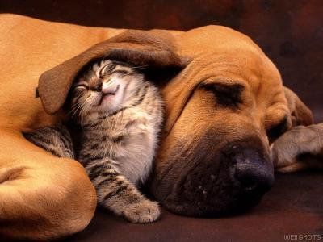
Help ensure that all animals are in a safe and happy home!

Slide 14
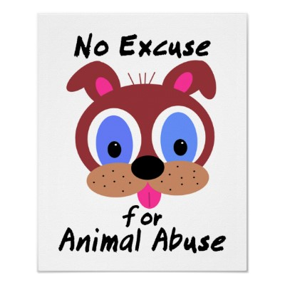
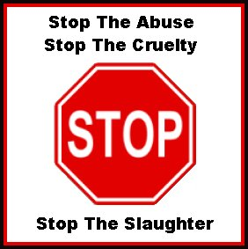
A Case for Animal Cruelty or Not?
Directions: As a group we will look at four cases. You will decide whether the case is considered animal cruelty or not. We will need a student to write peers responses on the board. Once everyone has shared their opinion, we will take a class vote for each case.

Slide 15

Case #1
The local Parks department has declared that the township is being overrun by deer. The population has grown so quickly that the food supply has not been able to keep pace. Deer are ruining crops and killing trees as a result of stripping bark from their trunks. A township task force is recommending an extended sports hunting season and lifting the limit of one deer per hunter to two deer per hunter. Cruel or Not Cruel? Why?

Slide 16
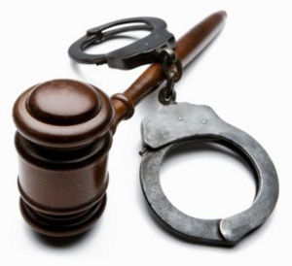
Case #2
Bull fighting is a form of entertainment in France, Spain, Portugal, Mexico, and Latin America. During a bullfight, bulls are deliberately angered and injured, and the finale is often the death of the bull. Supporters of bullfighting argue that it is a culturally important tradition, just as rodeos are in other parts of the world. Cruel or Not Cruel? Why?

Slide 17
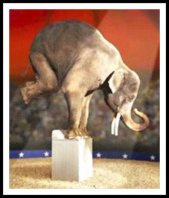
Case #3
Ethel, a 30-year-old performing circus
elephant, has developed arthritis in her hind legs rendering her unable to perform. Concerned that she would be unable to survive without constant attention and care, her owner has applied for a permit to put her down. Cruel or Not Cruel? Why?

Slide 18
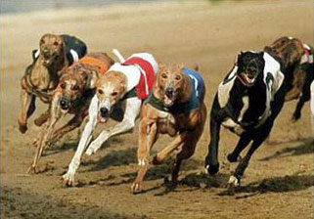
Case #4
Greyhound Racing is an important part of the economy in some cities. There are currently 34 tracks in 13 states. It takes an average of 1000 greyhounds to keep a track running. Racing greyhounds are considered by their breeders to be short term, disposable investments, and between 5,000 and 9,000 greyhounds are killed each year. Cruel or Not Cruel? Why?

Slide 19

Resources
http://www.dosomething.org/tipsandtools/11-facts-about-animal-cruelty
http://learningtogive.org/lessons/unit430/lesson2.html
http://www.aspca.org/fight-animal-cruelty/reporting-cruelty-faq.aspx

